Slide 1

Scripting Languages
Module 6
Writing Functions

Slide 2
Today’s Concepts
Functions Defined
Function Basics
Variable Scope
Command Substitution
Writing a Function

Slide 3
Learning Objectives
By the end of this Module you will:
Understand and execute scripts that use multiple functions
Send information into functions and retrieve results from functions
Use command substitution to solve problems

Slide 4


Functions Defined

Slide 5
What are Functions
Functions are aggregated blocks of code that exist under a declared name, and in combination, perform a highly specific task
They can be stored in the scripts that calls them to execute or in a separate file that is called in when the parent script is run
When a bash script is run, any Functions attached to it will be stored in memory ready for use when called upon
Functions are particularly useful for aggregating set of commands that are frequently required in bash scripts
Advantages of Functions
Avoid time-consuming repetition of commonly used code. Make scripts, especially complex scripts, more readable. Allow complex coding tasks to be broken down into much simpler ones. Reduce the likelihood of error – get right the first time, then reuse. Maintaining and updating scripts is much easier when core parts of it are comprised by common functions.

Slide 6
Function Basics

Slide 7
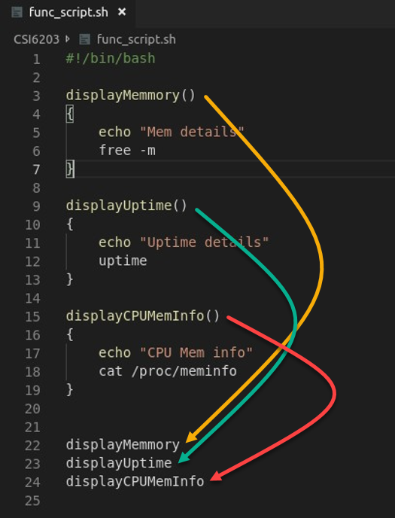
Where Do Functions Go
Functions are often placed into the head region of a script that will call upon them
They can also be placed in a separate file and called into a script using the source command, i.e. source func_script.sh
The uptime command shows how long the computer has been on
Functions do not execute unless they are called by name

Slide 8
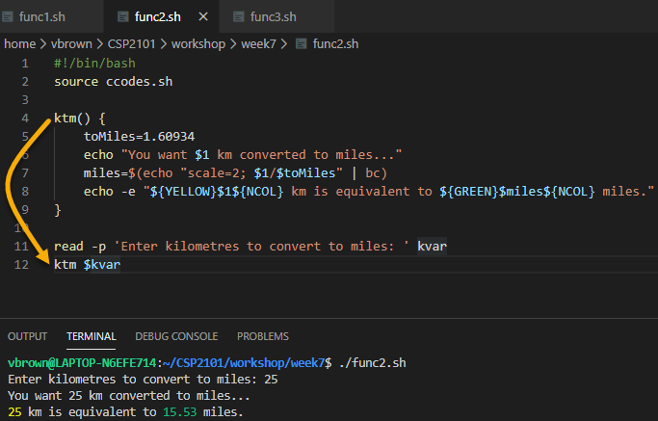
How to Call a Function
Functions can be created inside of scripts to allow for easy code re-use.
Instead of needing to copy-paste large sections of scripts, functions can allow the code to be executed by name
~/CSI6203

Slide 9
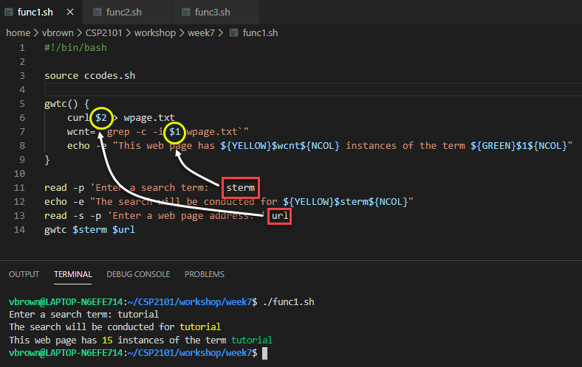
Function Arguments
Functions can have arguments, just like scripts.
The $#, $1 and $2 variables work the same way as they do in scripts
In many ways, functions can act as scripts within scripts
~/CSI6203
~/CSI6203

Slide 10
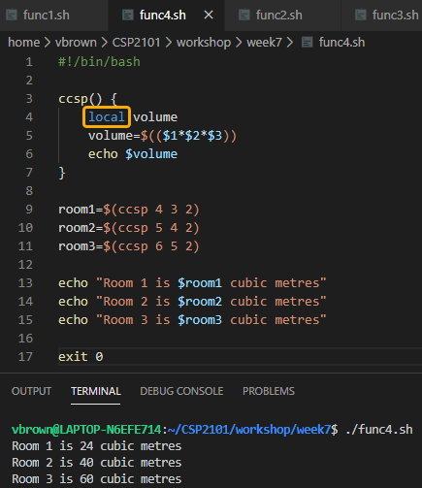
Variable Scope Within Functions
Scope refers to the parts of code where a variable can be used
By default, functions variables are considered global and can be used anywhere in the script
The danger of this is a variable name being used multiple times for different things
A better option is to declare variables inside functions as local
A local variable will only exist within the function and will go out of scope as soon as the function is finished
~/CSI6203

Slide 11
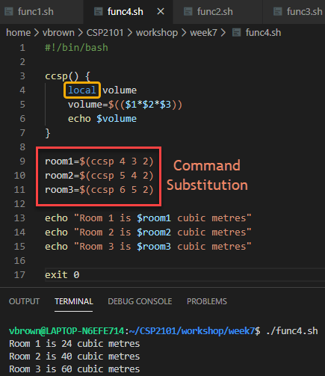
Command Substitution
Often functions will have local variables and echo the results to send data back to the script
This allows functions to be treated like mathematical functions which have a single result
This is done by using Command Substitution
Command Substitution allows the output of a command or function will be stored in variables instead of printed to the screen
~/CSI6203

Slide 12
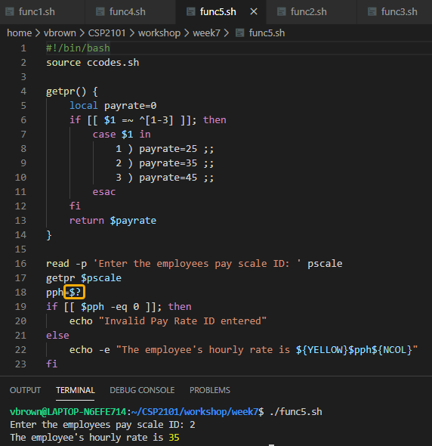
Return Values
Bash does have a return command similar to other languages.
However, the return command sets the exit_status of the function, so it can only return numeric values accessible using the $? variable
~/CSI6203

Slide 13
Writing a Function

Slide 14
Plan/Write a Function
Write a function that that calculates the average temperature for each week of daily maximums contained within an external .csv file
The output for each week should be - The average temperature in Week1 was 23 degrees Celsius
The function will need to first strip out the file’s header which does not form part of average temperature calculations
The original .csv file is not to be altered, so the modified data is to be placed into a temporary .txt file for processing
The user is to be prompted for the .csv input file, at which point the function will be invoked
Name the function calcstats
The script is to be named exf1.sh

Slide 15
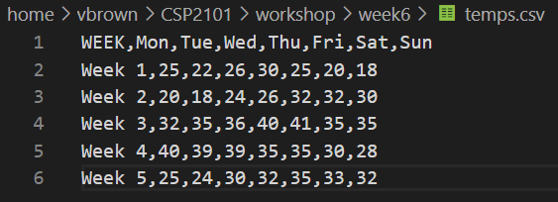
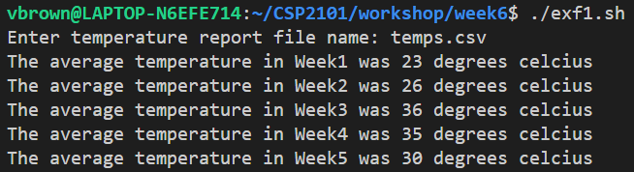
Example Functions
calcstats() {
# your code here
}
read -p 'Enter temperature report file name: ' tmprpt
if ! [[ -f $tmprpt ]]; then
echo "File not found"
exit 1
else
calcstats $tmprpt
fi
exit 0
This code is not to be altered
~/CSI6203

Slide 16
Function Breakdown
calcstats() {
}
Begin by inserting the fundamental function structure and giving it a name, in this case calcstats()

Slide 17
Function Breakdown
This code block looks for lines in the source file (provided to the function and held in the default variable $1) that do not contain any numeric values.
If the file contains a header, which contains no numbers, then the variable $lcount variable will be set to 1.
The status of $lcount (0 or 1) can then be used to determine subsequent script actions
lcnt=0
while IFS= read -r line
do
if ! [[ $line =~ [0-9] ]]; then
(( lcnt++ ))
fi
done < "$1“

Slide 18
Function Breakdown
if [[ $lcnt -eq 1 ]]; then
printf "%s\n\n" "$(tail -n +2 $1)" > tempraw.txt
fi
If $lcount is equal to 1, then the source file does contain a header, so we want to remove it before copying the data to a temporary file named tempraw.txt
To do this, the tail command has been used to print the contents of the source file to the temporary file from Line 2 (+2) onwards, this ensuring the header on Line 1 is not copied across to tempraw.txt

Slide 19
Function Breakdown
while IFS="," read -r week mon tue wed thu fri sat sun
do
tmpsum=$(($mon+$tue+$wed+$thu+$fri+$sat+$sun))
let tmpavg=$tmpsum/7
echo "The average temperature in $week was $tmpavg degrees celcius"
done < tempraw.txt 2>/dev/null
Setting the IFS to comma (,), setting tempraw.txt as the source and using a while loop, read each value on each line into the ordinally corresponding variable name, i.e. week mon tue etc.
Get the sum of each variable populated, excluding $week and assign to variable tmpsum, then get the average by dividing tmpsum by 7 and assign to variable tmpavg
Echo output regarding average temperature to the terminal

Slide 20
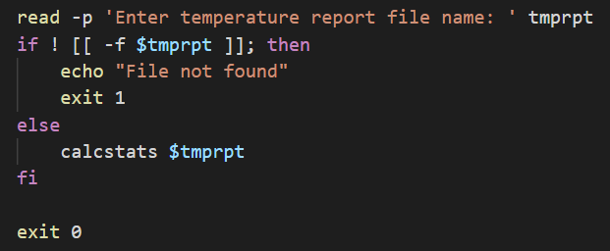
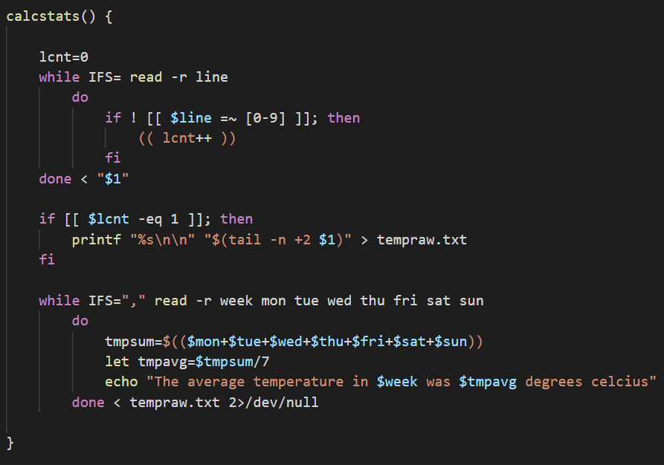
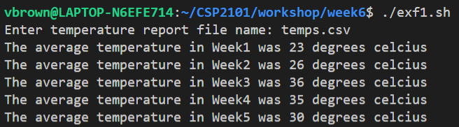
Function Breakdown
2
1
3
~/CSI6203

Slide 21


References and Further Reading
Ebrahim, M. and Mallet, A. (2018) Mastering Linux Based Scripting (2nd Ed) Chapter 7, pp 125-140
http://tldp.org/LDP/abs/html/functions.html http://tldp.org/HOWTO/Bash-Prog-Intro-HOWTO-8.html https://likegeeks.com/bash-functions

Slide 22
Terms to Review and Know
Functions
Function parameters/arguments
Variable scope
Command Substitution
Return

